Slide 1
Real-Time Object Detection with YOLOv8
Jakub Spišák, Lubomír Švec, Daniel Zemančík

Slide 2
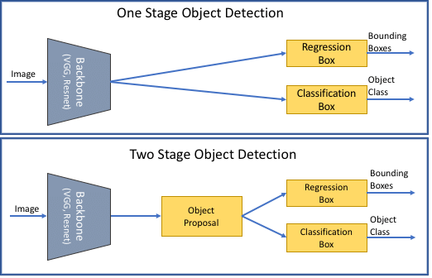
Object Detection and YOLO
YOLO (You Only Look Once) is a one-stage, real-time detector known for speed and efficiency

Slide 3
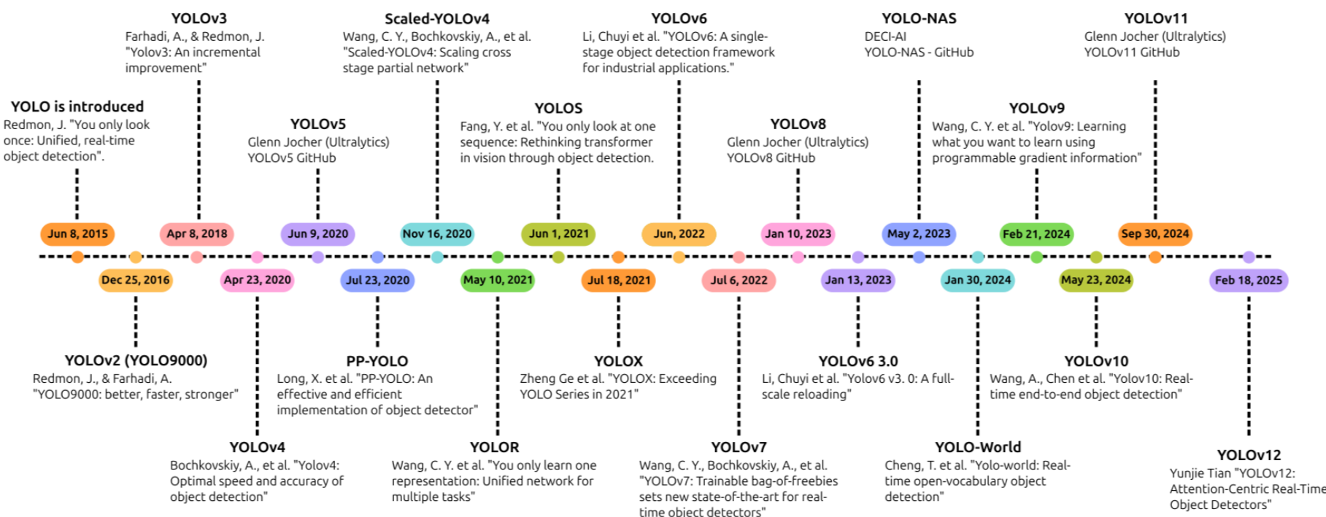
Evolution of YOLO

Slide 4
Project Objective and Methodology
Evaluate the performance of YOLOv8s on COCO dataset
Preparation of the Dataset
Model initialization
Training and optimization
Evaluation of the results

Slide 5
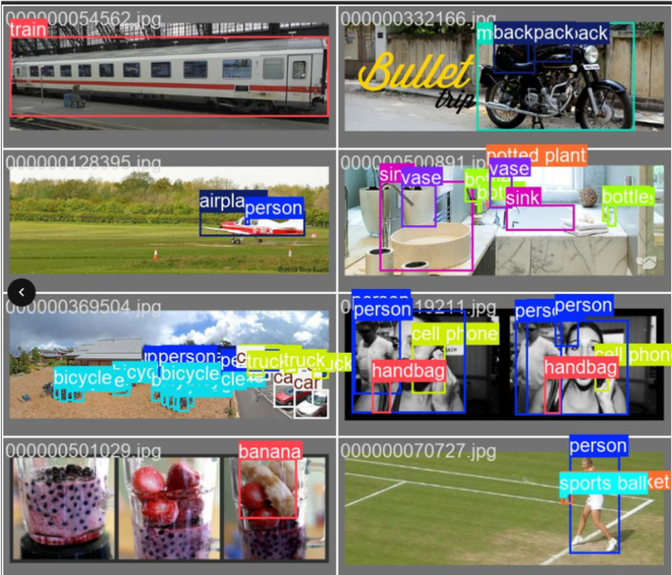
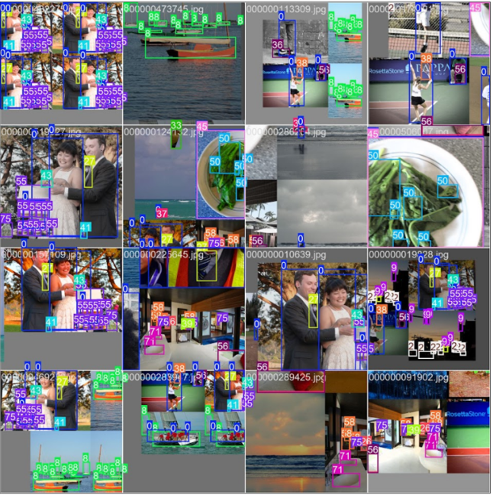
COCO Dataset
80 diverse object categories, ~120K images
70/15/15 split for train/val/test

Slide 6
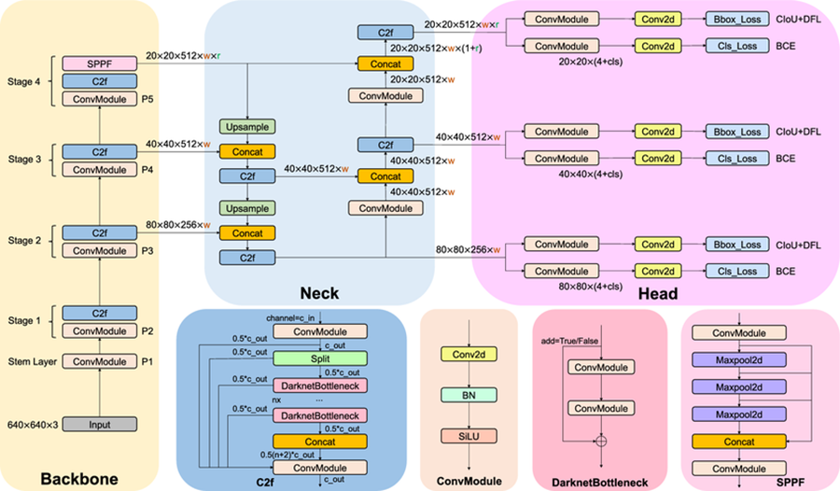
YOLOv8 Architecture Overview
High-level overview of how input image flows through the network

Slide 7
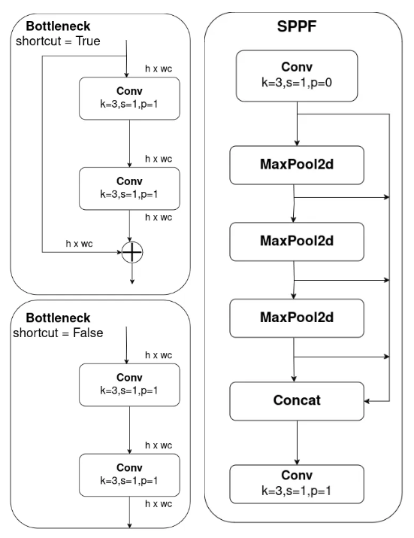
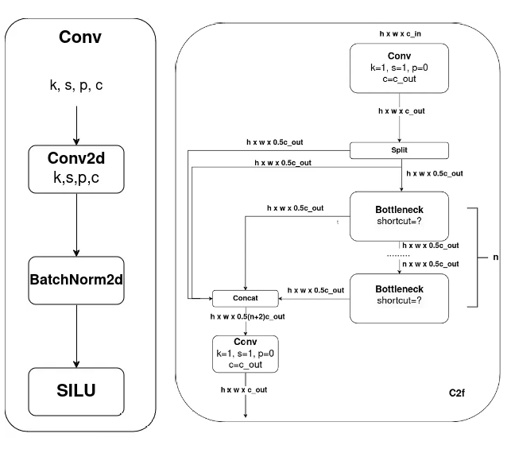
Core modules of YOLOv8 architecture

Slide 8
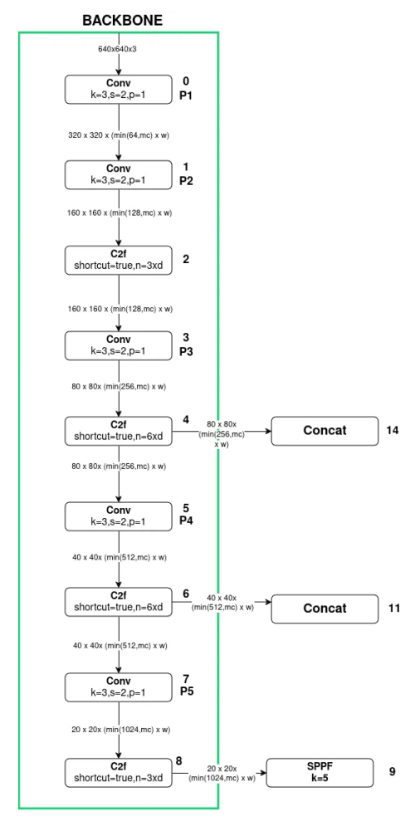
Backbone – Feature Extraction
CSPDarknet-based
Uses C2f modules for efficient feature extraction
Outputs P3, P4, P5 at different scales
Spatial Pyramid Pooling – Fast sits at the end of backbone
Aggregates multi-scale context

Slide 9
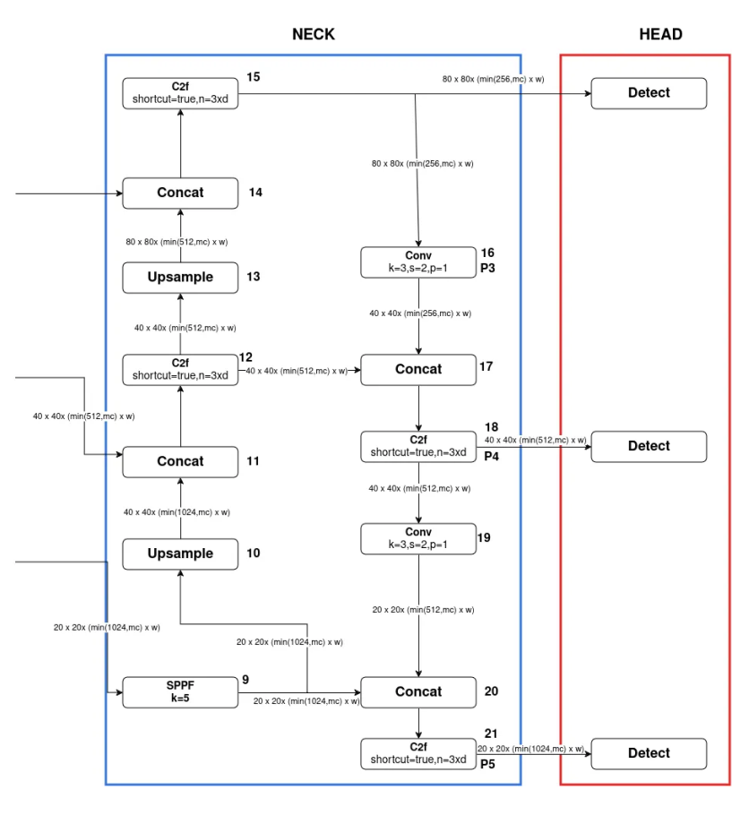
Neck – Feature Aggregation
FPN and PAN flow with P3', P4', P5'
Combines high-level semantics with low-level details
Bi-directional feature flow enables multi-scale detection

Slide 10
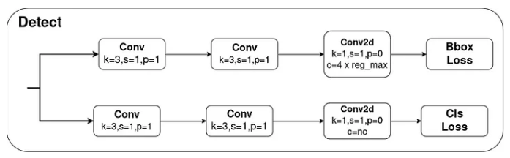
Anchor-Free Decoupled Head
Separate branches for bounding box and class prediction
Uses Distribution Focal Loss with reg-max bins
No anchor boxes – simplifies training

Slide 11
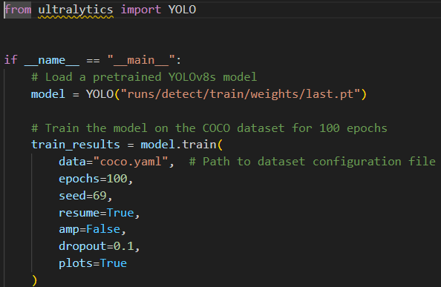
Training Setup
resume - multi-session training from last.pt (model from last checkpoint)
amp - Automatic Mixed Precision, allows smaller data types to free memory
Checkpoints after each epoch
Hidden attributes such as image size, batch size, optimizer…
Results - last model after epoch 100, best model from the entire run

Slide 12
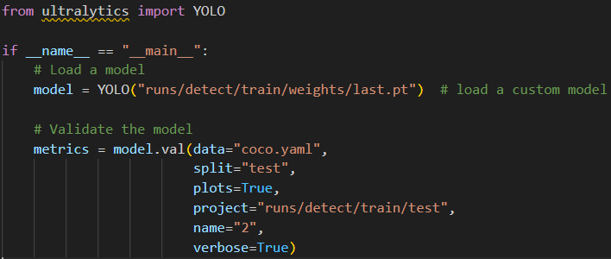
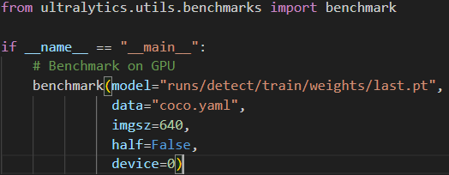
Testing Setup
Testing the trained models on 15% of data
Regular testing - for quality of the model
Benchmark testing - for speed vs precision per export possibility

Slide 13
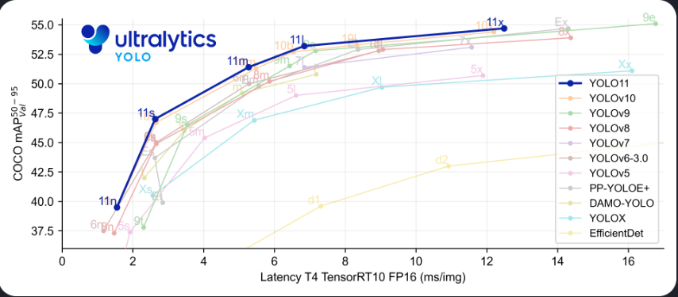
Test results

Slide 14
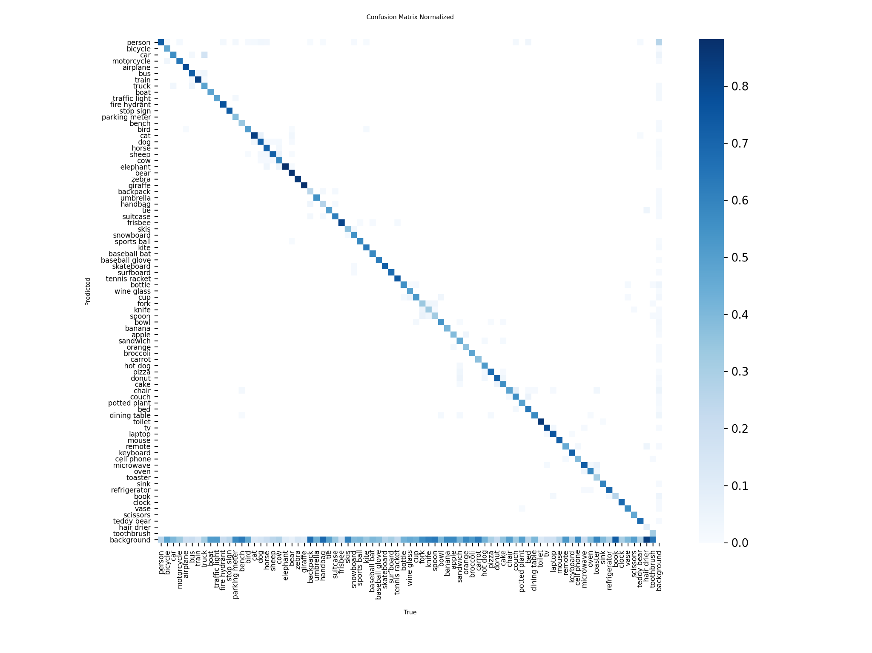
Test results
X - True, Y - Predicted
Best detection: Person, Airplane, Train, Cat, Elephant…
Worst detection: Background - confusing background with object
Precision = 70%
Recall = 56%
F1 = 61%
mAP50-90 = 45.5

Slide 15
Benchmark results
 | Size(MB) | mAP50-95 | Inference Time | FPS
PyTorch | 21.5 | 0.4548 | 7.3 | 137
TorchScript | 43 | 0.4514 | 5.81 | 172
OXNN | 42.8 | 0.4514 | 8.52 | 117
MNN | 42.7 | 0.4513 | 60.92 | 16
NCNN | 42.7 | 0.4514 | 67.223 | 14

Slide 16

Test video

Slide 17
Conclusion
YOLOv8 offers strong real-time object detection with an anchor-free, decoupled architecture
Key components like CSPDarknet and BiFPN improve multi-scale feature learning
Evaluation on the COCO dataset showed solid results, with an mAP50-90 score of 45.5%
Benchmarking confirms a good balance between speed and accuracy
Future improvements could include fine-tuning for specific tasks or real-world deployment

Slide 18
Thank you for your attention!

